Slide 1

8tracks Windows player
Matija Lukić
OOTI C-2011
TU Eindhoven

Slide 2
Agenda
8tracks concept
Goals for the mini project
Design
Technologies
Methodology
Demo
Future

Slide 3
8tracks concept
A free handcrafted internet radio
Mimics radio-listening experience
Reviving the mix-tape culture (UGC)
It feels like a radio, because you:
Don’t know the exact tracks coming up next
Don’t hear the same artist over and over again
Can’t time-travel

Slide 4
My goals
8tracks without a browser and ‘noise’
Expanding .NET stack knowledge
Developing an app with GUI
Making a product that will really be used by:
Me,
People around me, and
People I’ve never met.

Slide 5
Process
Proof of concept
User stories
Research on SotA
Construction
Deployment
Next steps… ?

Slide 6
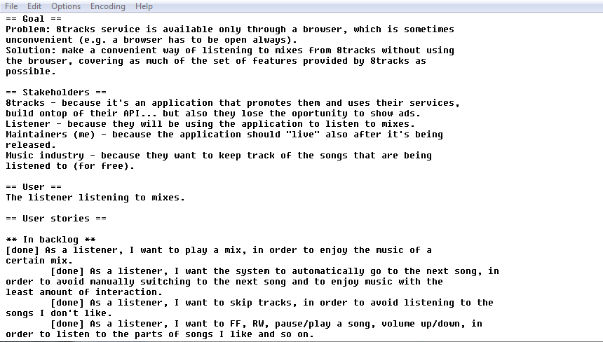
Keeping it lean all the time

Slide 7
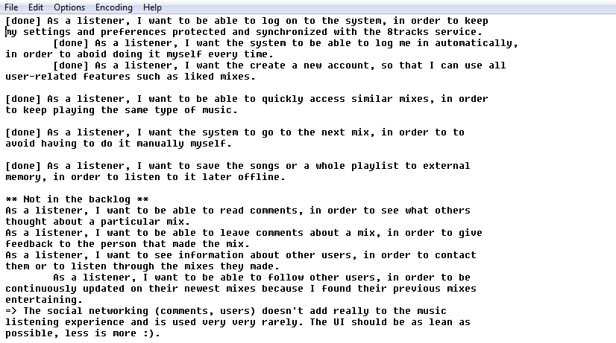
Keeping it lean all the time

Slide 8
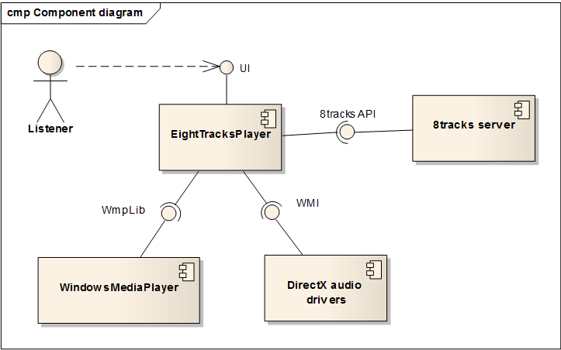
Design
Environment

Slide 9
Design
Architectural approach
Infrastructure
Domain
Application
User Interface
Views
ViewModels
Domain (incl. models)
Comm
Media

Slide 10
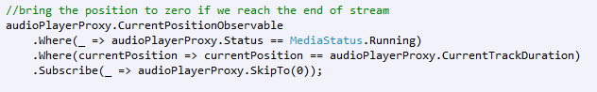
Technologies
Rx + LINQ
Reactive, event driven programming model +
(Practically) No events, nor loops in the code ☺

Slide 11


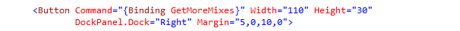
Technologies
WPF + RxUI
Testable and very clean

Slide 12
Methodologies
1 week sprints, user story breakdown
Google docs for task management
Diagnosis with NLog + Growl notification system
Code metrics
TDD + BDD with StoryQ framework
Auto-generated testing report
Refactoring and emerging design

Slide 13
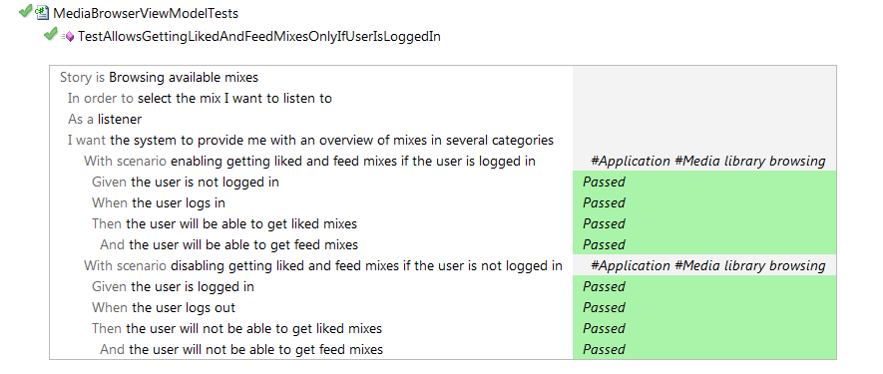
Methodologies
BDD test example
Notes:
It’s 1 of 100 tests that are made

Slide 14
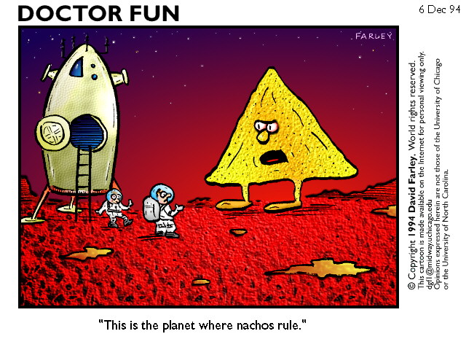
And now, the deemo ☺

Slide 15
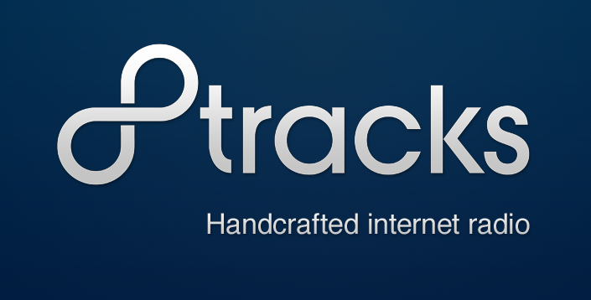
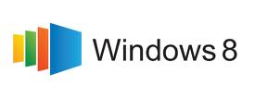
The future
Dus… vragen?

Slide 16
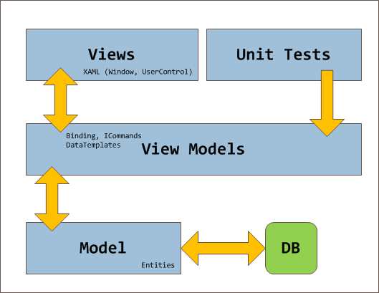
MVVM explained

